Slide 1
RSAT REST API

Slide 2
Achievements during the hackathons
Coverage of the initial goals
Add entry points required for the project "Workflow for the analysis of disease-associated regulatory variants": variation-info, retrieve-variation-seq, variation-scan
Develop a detailed documentation for the existing and new entry points.
Implement small test and demo scripts invoking these web services with various languages: python, perl, java, R.

Slide 3
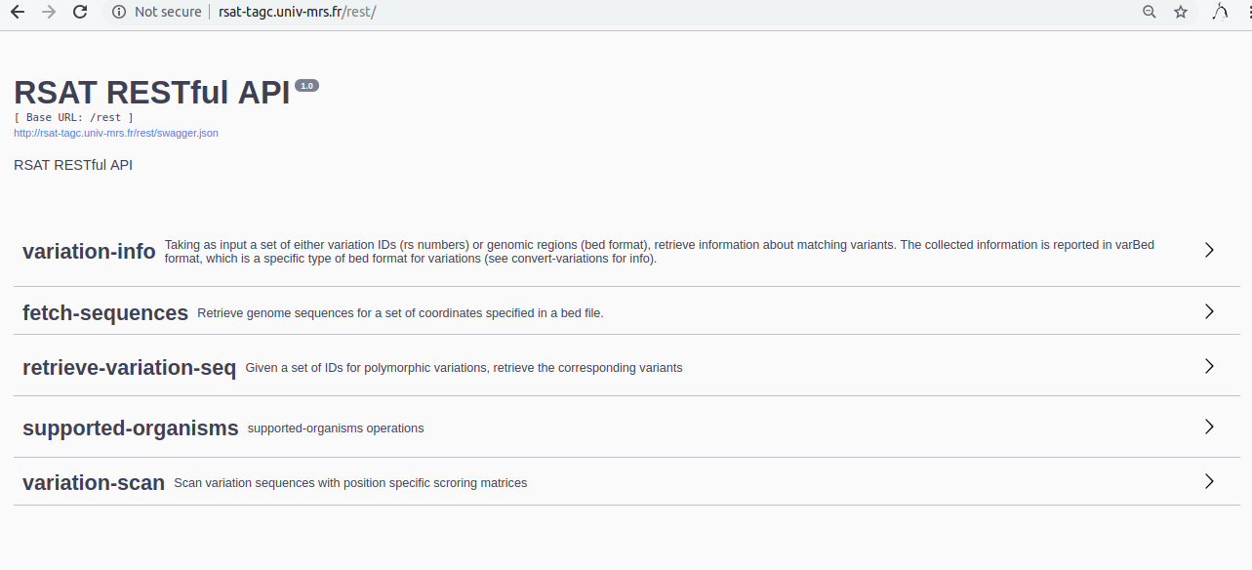
Illustration of the results
Interface web for the documentation

Slide 4
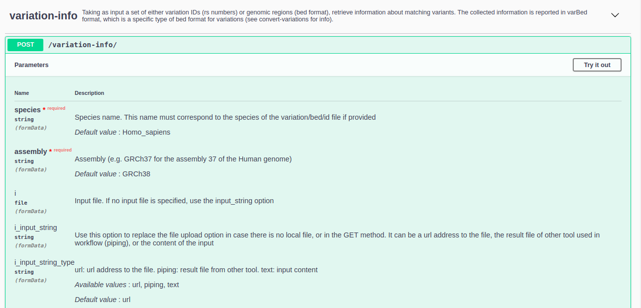

Slide 5
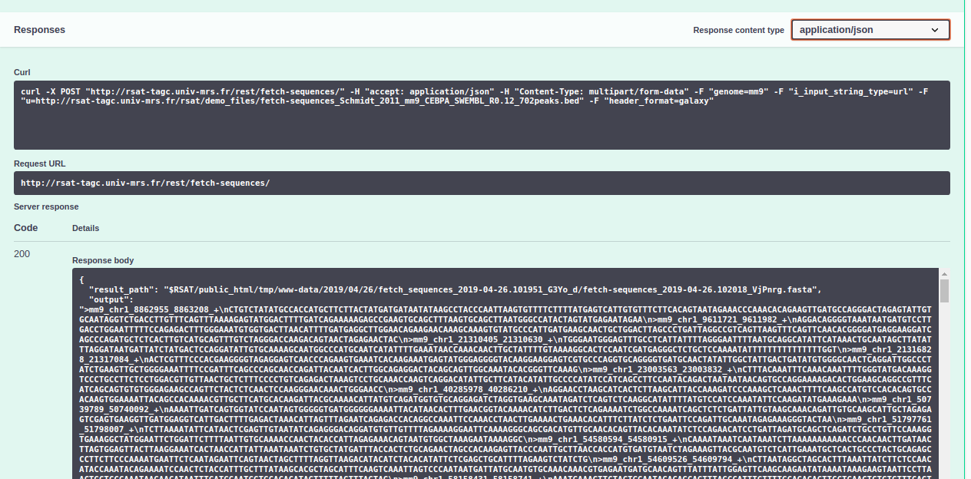

Slide 6
What remains to be done
Add new entry points for other tools
Add more options for returning response
Already have: json and text
Add: yaml, xml, etc.
Implement a nicer interface for the API documentation
Create demo scripts for client in other languages
Write a detail user guide

